Slide 1



IMPACT OF INFLATION ON CONSUMER SPENDING IN NIGERIA
Damilola Olanrewaju

Slide 2
OUTLINE
Introduction
Overview
Key Questions
Findings & Insights
Summary

Slide 3

INTRODUCTION
This is my entry for the Data Analytics competition organized by Cortouch Media, a leading Tech Training Organization in Ibadan, Nigeria.
3

Slide 4

OVERVIEW

Slide 5
“To Analyze the Impact of Inflation on Consumer Spending in Nigeria”
OBJECTIVE
5

Slide 6

Key Questions
How has the CPI changed over time?
How does the monthly inflation trend compare to the yearly inflation trend?
How does the current inflation rate compare to previous rates?
Impact of inflation on consumer spending in Nigeria
6

Slide 7

Findings & Insights

Slide 8
Findings & Insights - Overview
The base year was 2009, precisely in November with a CPI of 100.
A weighted average index of 1000 was used to represent the average total index of all goods and services.
Total Food Index is 507.06, contributing 50.7% of the weighted average, while the core CPI contributes 40.6% (405.55).
A line chart best demonstrates the trend of a variable over time.
8

Slide 9
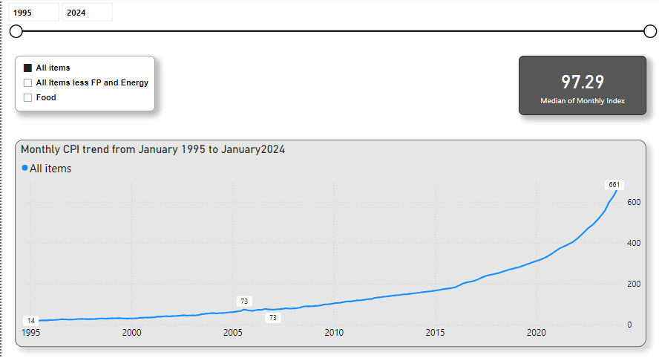
How has the CPI changed over time?
January 1995
November 2009
January 2024
There’s been a gradual increase in the monthly price index for all items from 1995 to 2024.
The lowest Monthly CPI was 14.30 in Jan 1995, and the highest was 660.78 in Jan 2024, with an average CPI of 97.29. This implies an approximately 46-fold (4500%) increase in the prices of goods and services over 29 years.
14.30
100.00
660.78
9

Slide 10
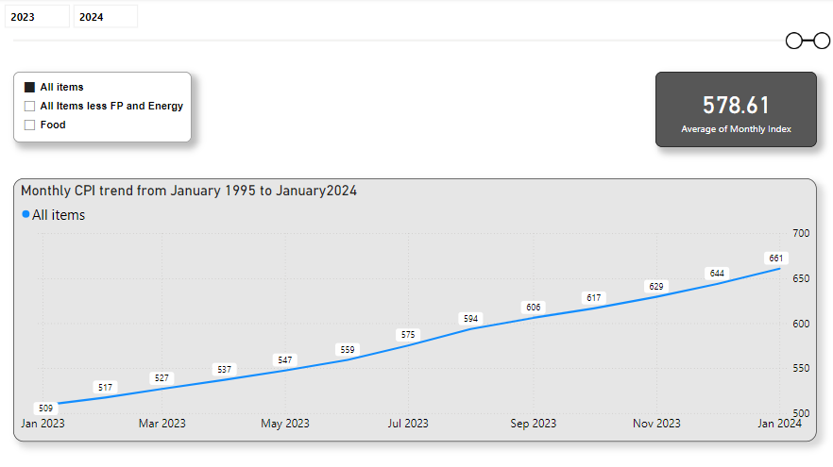
How has the CPI changed over time?
January 2023
January 2024
A more recent comparison from Jan 2023 to Jan 2024 would help understand the current state.
CPI average from Jan 2023 to Jan 2024 was 578.81.
The CPI in Jan 2023 was 508.69 and rose to 660.78 in Jan 2024, a significant increase of 152.09 points.
508.69
660.78
10

Slide 11
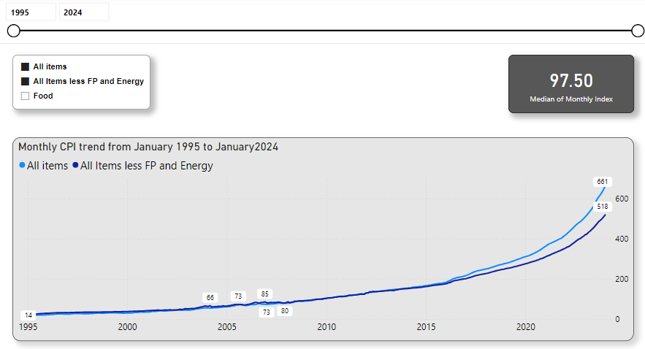
How has the CPI changed over time?
The core CPI (All Items less Farm produce and Energy) was not significantly different from the All-items CPI from 1995 until about 2016 when they became significantly different.
This sharp difference (All Items index > core CPI) indicates a significant rise in Farm produce and Energy prices, which are known to be volatile.
However, the core CPI index still rose to a maximum of 518.21 in Jan 2024, accounting for a 1.24-fold (about 25%) price increase from Jan 2023.
11

Slide 12
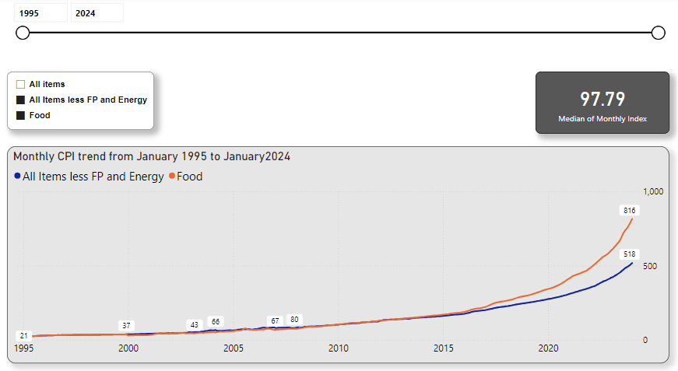
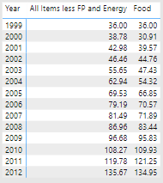
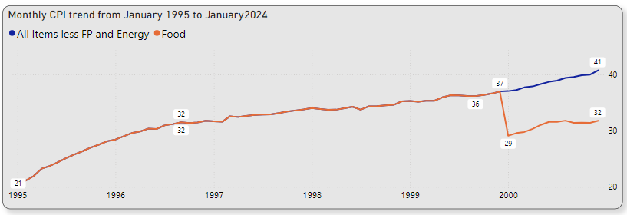
How has the CPI changed over time?
A similar trend is seen when comparing core cpi to the food price index with a bifurcation in the price indices around 2016.
The monthly food index and core cpi index were the same until 2000.
Food contributes significantly (50.7%) to the overall consumer price index (All Items).
12

Slide 13
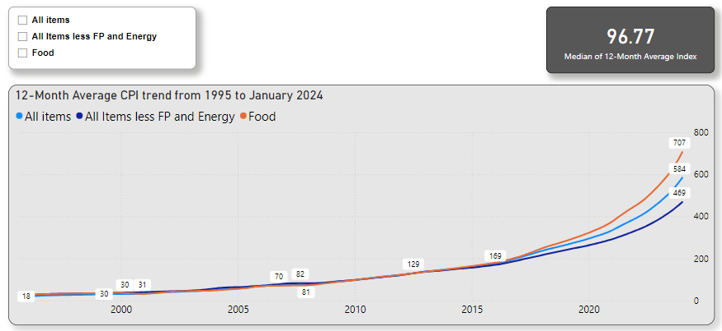
12-Month Average CPI Trend
The 12-Month Average CPI data shows a similar trend to the Monthly CPI trend.
The impact of farm produce and energy price index is obvious on the All Item price index when compared with the core index in Jan 2024 12-Month average CPI, a difference of 115.82.
13

Slide 14
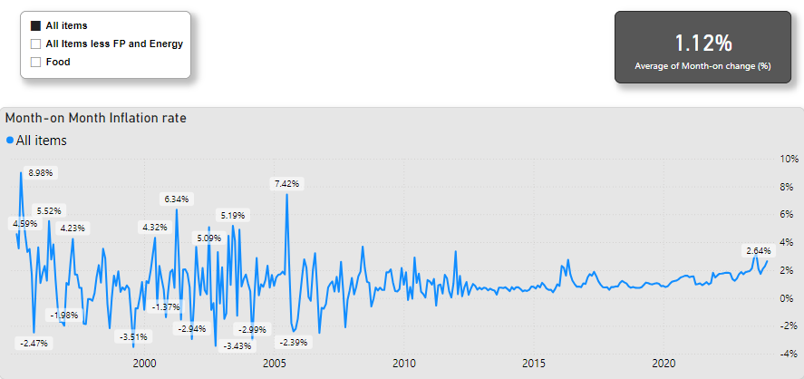
Month-on-Month Inflation – All Items
Month-on-month inflation | Value
Average | 1.12%
Maximum | 8.98% - April 1995
Minimum | -3.51% - August 1999
Dec 2023 | 2.26%
Jan 2024 | 2.64%
14

Slide 15
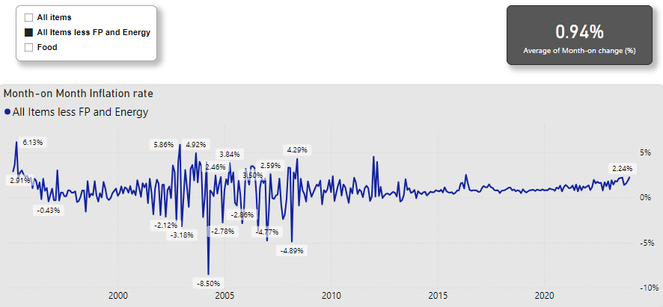
Month-on-Month Inflation – Core CPI
Month-on-month inflation | Value
Average | 0.94%
Maximum | 6.13% - April 1995
Minimum | -8.50% - April 2004
Dec 2023 | 1.82%
Jan 2024 | 2.24%
15

Slide 16
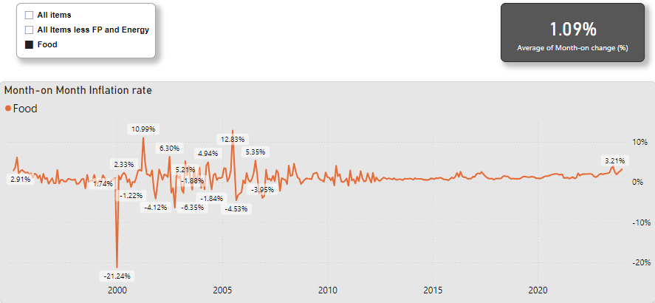
Month-on-Month Inflation – Food
Month-on-month inflation | Value
Average | 1.09%
Maximum | 12.83% - July 2005
Minimum | -21.24% - Jan 2000
Dec 2023 | 2.72%
Jan 2024 | 3.21%
16

Slide 17
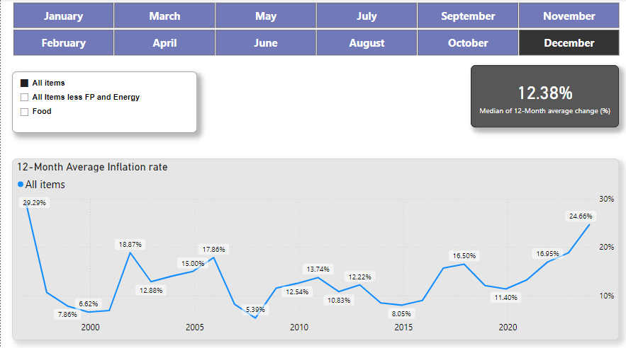
12-Month Average Inflation – All Items
12-Month Average inflation | Value
Average | 12.38%
Maximum | 29.29% - Dec 1996
Minimum | 5.39% - Dec 2007
Dec 2023 | 24.66%
Jan 2024 | 25.35%
17

Slide 18
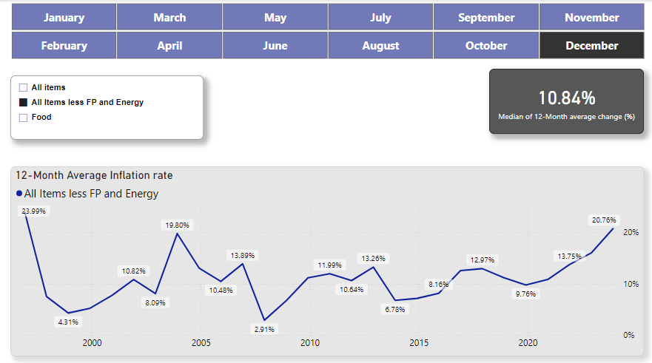
12-Month Average Core Inflation
12-Month Average inflation | Value
Average | 10.84%
Maximum | 23.99% - Dec 1996
Minimum | 2.91% - Dec 2007
Dec 2023 | 20.76%
Jan 2024 | 21.15%
18

Slide 19
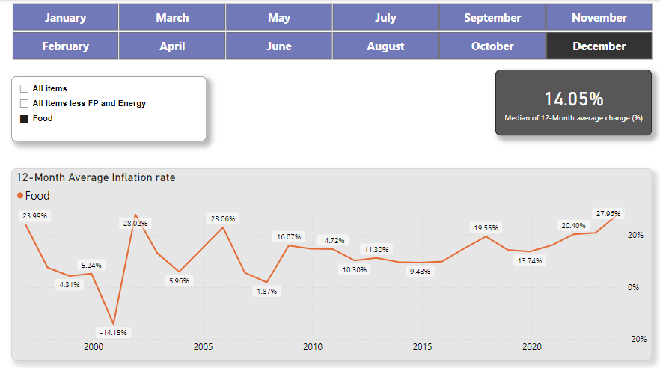
12-Month Average Food Inflation
12-Month Average inflation | Value
Average | 14.05%
Maximum | 28.02% - Dec 2001
Minimum | -14.15% - Dec 2000
Dec 2023 | 27.96%
Jan 2024 | 28.91%
19

Slide 20
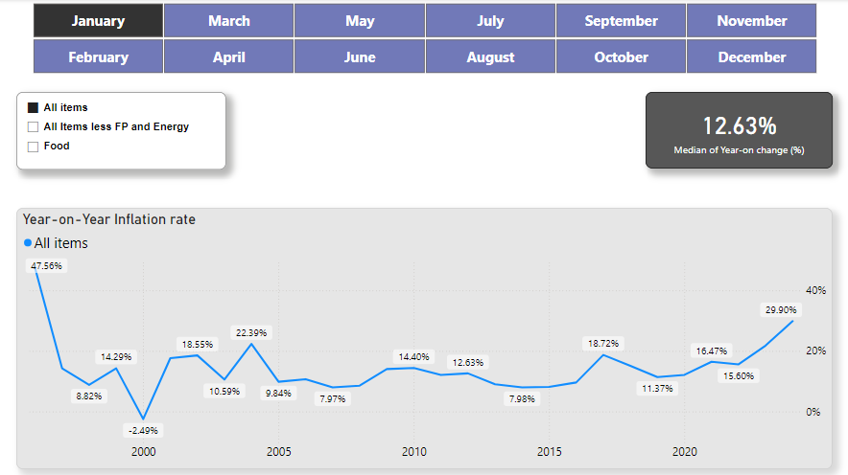
Year-on-year Inflation – All Items
Year-on-year inflation | Value
Average | 12.63%
Maximum | 47.56% - Jan 1996
Minimum | -2.49% - Jan 2000
Jan 2023 | 21.82%
Jan 2024 | 29.90%
20

Slide 21
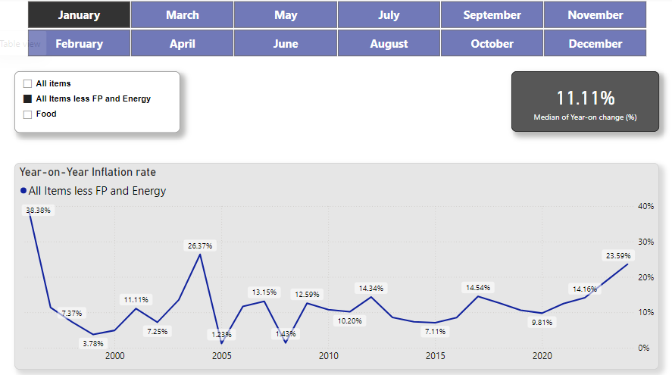
Year-on-year Inflation – Core Inflation
Year-on-year inflation | Value
Average | 11.11%
Maximum | 38.38% - Jan 1996
Minimum | 1.23% - Jan 2005
Jan 2023 | 18.88%
Jan 2024 | 23.59%
21

Slide 22
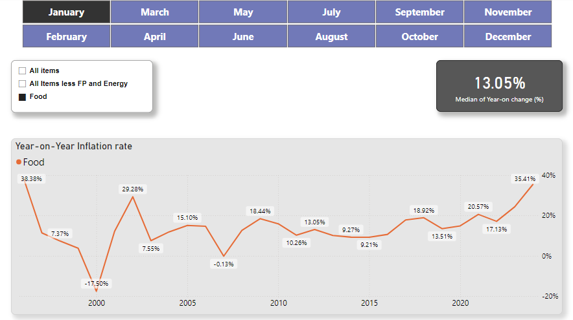
Year-on-year Inflation – Food
Year-on-year inflation | Value
Average | 13.05%
Maximum | 38.38% - Jan 1996
Minimum | -17.50% - Jan 2000
Jan 2023 | 24.32%
Jan 2024 | 35.41%
22

Slide 23

Summary
Both monthly and 12-month average CPIs have a generally increasing trend. Although there are occasional periods where CPI decreases.
Month-on-month | All-Items | Core | Food
Average | 1.12% | 0.94% | 1.09%
Dec 2023 | 2.26% | 1.82% | 2.72%
Jan 2024 | 2.64% | 2.24% | 3.21%
Year-on-Year | All-Items | Core | Food
Average | 12.63% | 11.11% | 13.05%
Jan 2023 | 21.82% | 18.88% | 24.32%
Jan 2024 | 29.90% | 23.59% | 35.41%
12-month Average | All-Items | Core | Food
Average | 12.38% | 10.84% | 14.05%
Dec 2023 | 24.66% | 20.76% | 27.96%
Jan 2024 | 25.35% | 21.15% | 28.91%
23

Slide 24
Conclusion
From 1995 to 2024, consumer price Indices have risen substantially, with the food sector contributing the largest share to the CPI.
Recent data show sharp increases in inflation rates, which signals a heightened economic strain on consumers.
Food and energy prices need to be stabilized as this would positively impact the consumer’s purchasing power.
You can interact with the PowerBi report here.
Impact of inflation on consumer spending in Nigeria
24

Slide 25
References
https://www.investopedia.com/terms/c/consumerpriceindex.asp
https://www.bls.gov/cpi/questions-and-answers.htm
Impact of inflation on consumer spending in Nigeria
25

Slide 26

Thank you
Damilola Olanrewaju
email
LinkedIn

